Slide 1

Face Detector
Using non-high-Level Functions

Slide 2

Agenda
Objective
Methodology
Results
Conclusions

Slide 3


Introduction
Face detection and recognition have become increasingly important in today's world, with applications ranging from security to social media. In this presentation, I will walk you through the methodology we used to develop a simple face detection algorithm built from scratch without relying on high-level libraries or pre-trained models.

Slide 4

Objective
Scientific Approach

Slide 5
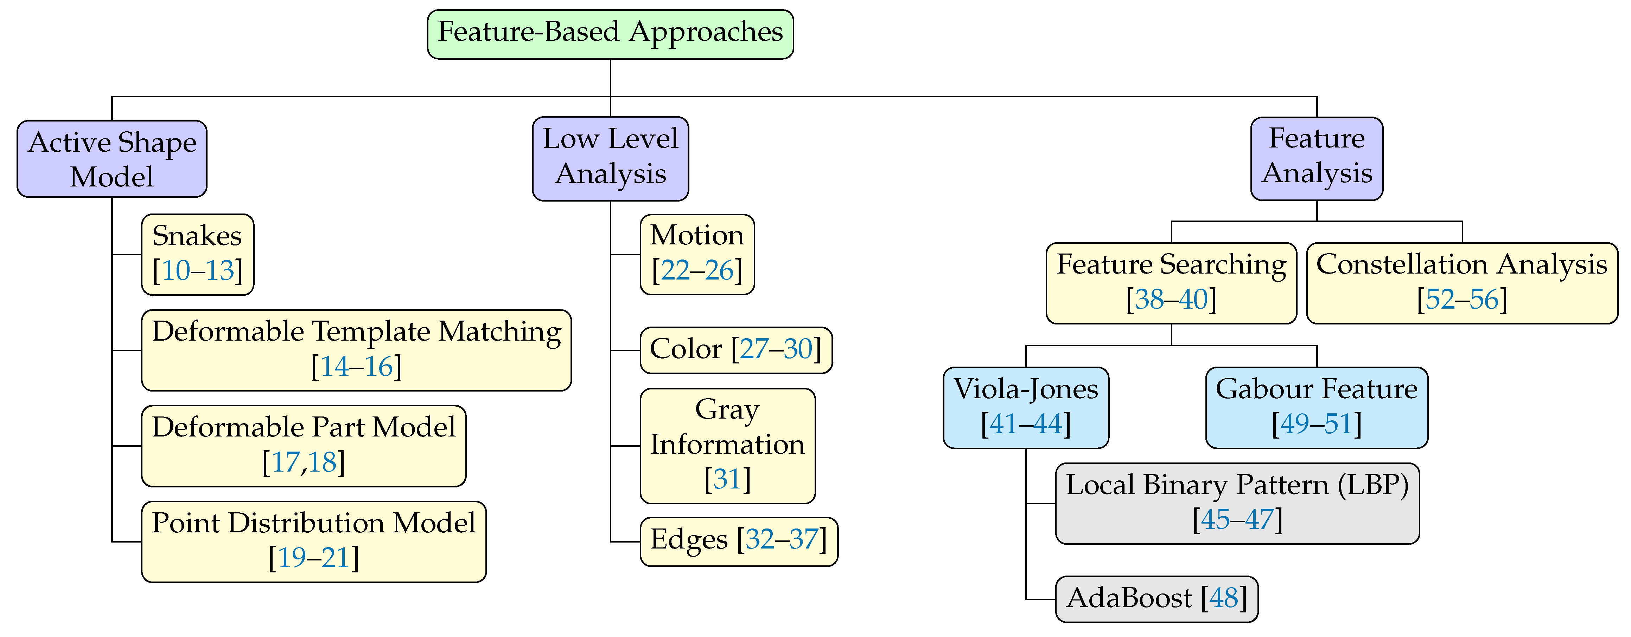
Possible Approaches

Slide 6
Content 2
Active Shape Model
Low Level Analysis
Feature Analysis
The system Links with Facial Features such as nose, mouth, etc.
The coordinates of those parts are then taken as a map and then a face mask is generated.
The system depends on several number of independent descriptors such as edges, color information, etc.
It doesn’t care for the perspective of the viewer.
Depends on high level functions that rely on 2 ways:
Positioning the face features by the relative position and the other is flexible face structures.

Slide 7
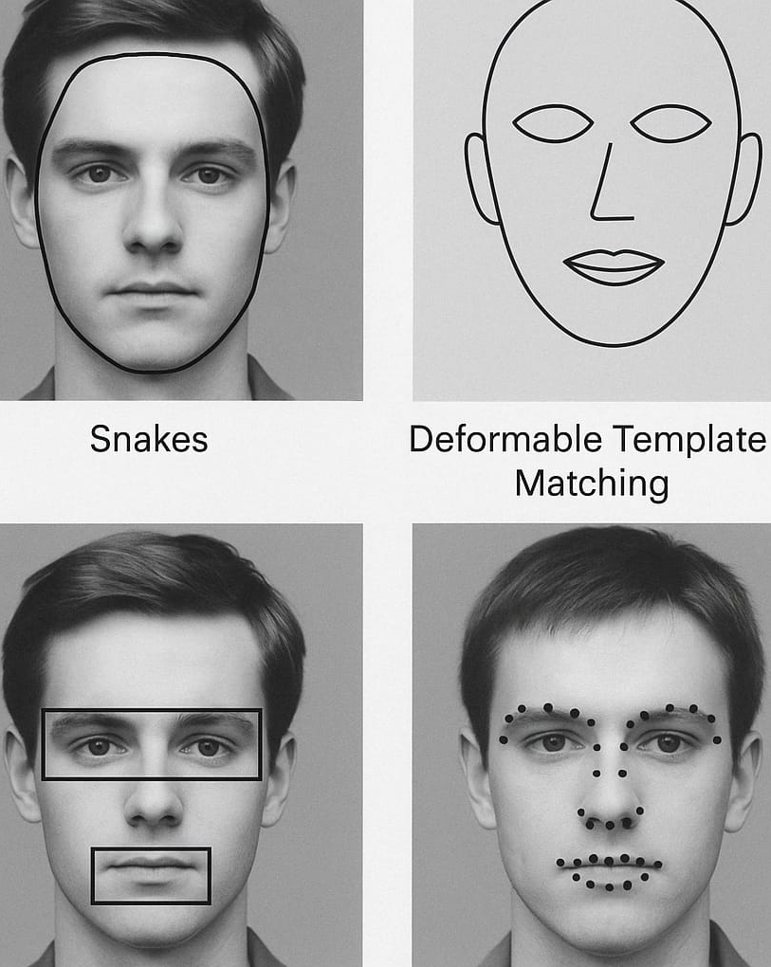
Active Shape Model
Snakes are commonly utilized in locating the head boundaries
Deformable Template Matching works by forming deformable shapes of the face which is achieved by predefined shapes. It suffers from detecting faces with various shapes
Deformable Part Model is a training-based model. It works by modeling discrete parts (eyes, nose, mouth) then a set of geometric constraints are set between these parts describing the distance between the eyes and the nose
PDM is a face Description technique that relies on landmark points depending on a training set of images

Slide 8
Low Level Analysis
Motion based face Detection relies on a number of continuous image frames and then use leading image contours and frame variance analysis.
Color Information suggests that skin color information builds a skin color cluster which leads to faster face detection.
Gray Information deals with grayscale images so it’s much less complex because it’s 2 Dimensional processing.
Edge is the earlies technique in computer vision that detects sharp change in image brightness to be then analyzed and finally detect face features.

Slide 9
Feature Analysis
FA theorizes the possibility that the human face has features that function as detectors, observing individual characteristics or features we can locate on the face. LLA sometimes detects noise (background objects) as faces, which can be solved, using analysis of high level features. Geometrical face analysis was employed rigorously to find the actual face structure, which was obtained ambiguously in low level analysis. Using the geometric shape information, there are two ways that we can put it into application. The first is the positioning of face features by the relative position of these features, and the other is flexible face structures.

Slide 10

Methodology
Low Level Analysis

Slide 11
Chosen Approach
We chose a low-level color analysis approach for this project for several key reasons:
It does not rely on pre-trained images or datasets.
It offers relatively fast performance for real-time processing
It is easier to design and implement within a short development timeframe
It allows modular development, enabling each team member to work on a separate component of the system

Slide 12
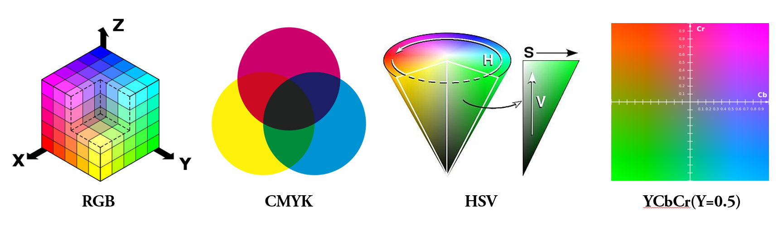
Color System
We use the YCbCr color space for its effectiveness in detecting skin tones. It separates brightness from color, making it easier to create a face mask. It has three components:
Y: Brightness (luminance)
Cb: Blue color difference
Cr: Red color difference

Slide 13
Web Cam Differences
While testing, we noticed that the face mask worked on some devices but not others. After some trial and error, we found that the Cr value was the key factor affecting detection. To make the system more flexible, we added a simple slider in the app that allows users to adjust the Cr minimum and maximum values as needed. We also included a default button to reset the range to Cr min = 133 and Cr max = 140.

Slide 14

Results
Before and After Calibration

Slide 15
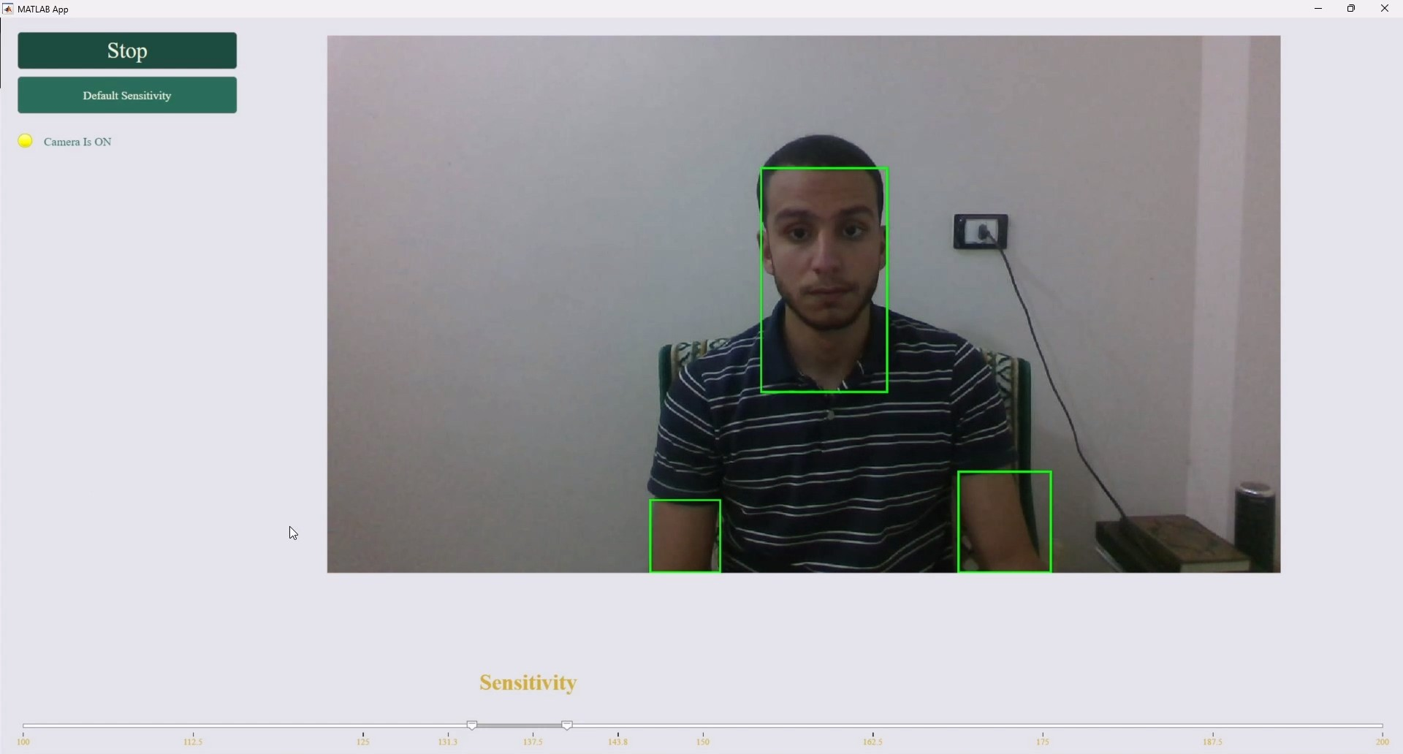
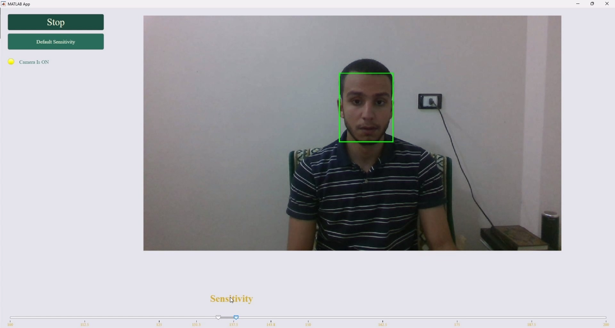
Fig 1

Slide 16
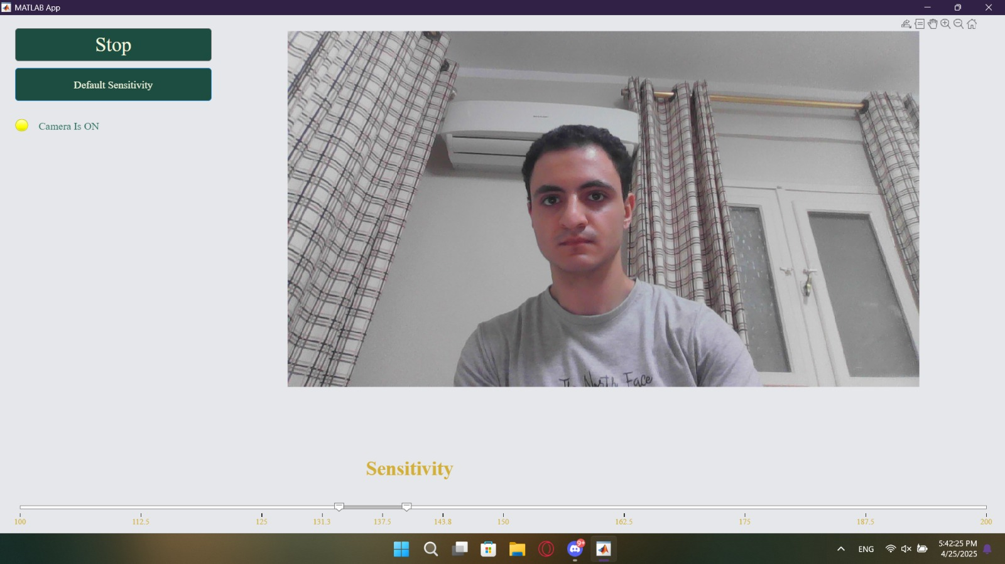
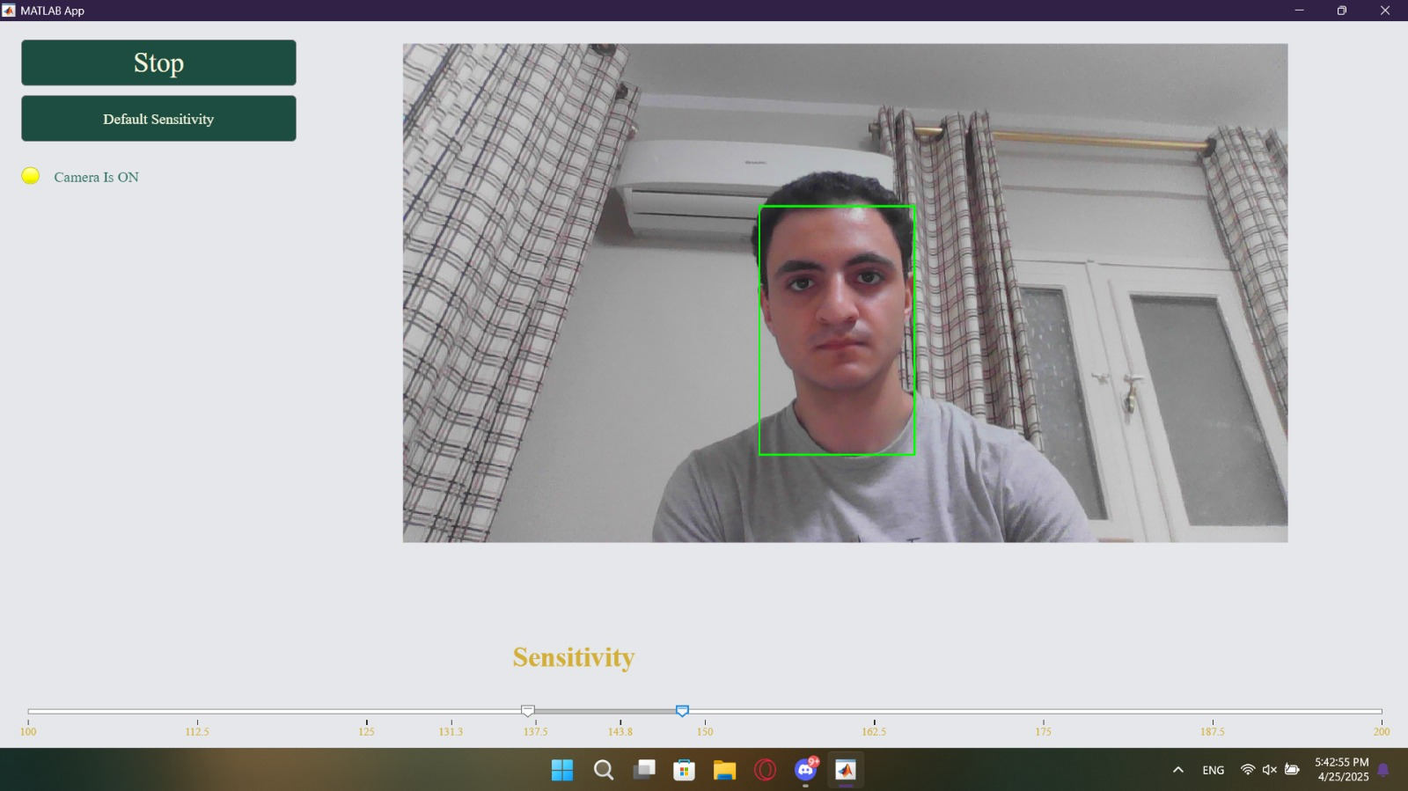
Fig 2

Slide 17

Conclusions

Slide 18
Sensitivity Calibration
As shown in Figure 1.1, the program initially detected the skin on the arm as a face because it fell within the Cr value range. After calibration, it correctly detected only the face. Similarly, in Figure 2.1, no detection occurred at first, but after adjusting the Cr values, the face was successfully detected in Figure 2.2.

Slide 19
Final thought
In this project, we built a basic face detection system using low-level color analysis with the YCbCr color space. By adjusting the Cr value range, we were able to improve accuracy across different devices. The result is a lightweight, customizable face detector that works in real time without relying on advanced libraries or pre-trained models.

Slide 20

The Best Vision is insight
Malcolm Forbes

Slide 21

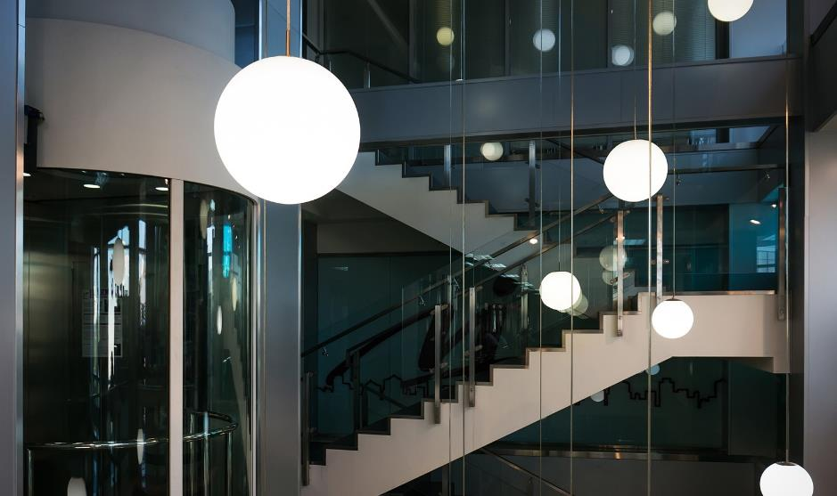
THANK YOU

